Slide 1
Predicting CVD Positivity & Negativity
By Demarcus Wirsing

Slide 2
Objective Goals of this current report
Explore CVD Features in relation to themselves and CVD positive and negative results.
Model Comparison: I will be comparing two very commonly used classification models for accuracy: Logistic Regression and Decision Tree Classification.

Slide 3
Features and Target
Features
AGE: integer (years of age)
WEIGHT: integer (kg)
GENDER: categorical (0: female, 1: male)
AP_HIGH: systolic blood pressure, integer
AP_LOW: diastolic blood pressure, integer
CHOLESTEROL: categorical (1: normal, 2: above normal, 3: well above normal)
GLUCOSE: categorical (1: normal, 2: above normal, 3: well above normal)
BMI: integer
Target
CARDIO: categorical (0: no, 1: yes)

Slide 4
CVD Background
Cardiovascular disease (CVD) is a group of conditions that involve the heart and blood vessels. Common complications include heart attack, chest pain (angina), or stroke.
One person dies every 37 seconds from CVD in the US
CVD is the leading cause of death in the US more than all deaths from cancer and the number of lives lost is increasing, year after year.
By 2030, over 1 million people in the US could die each year from CVD.

Slide 5
Data Source Info
Cardiovascular Dataset
This dataset contain exactually 70k entries with 13 different attributes.
Each entry is unique as the attributes contains different health levels.
All 12 columns are measured towards the ‘cardio’ column which determines if you have the disease or not.

Slide 6
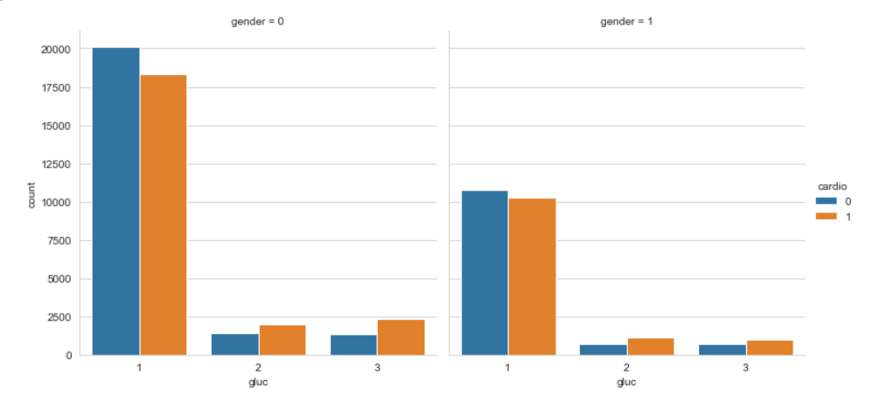
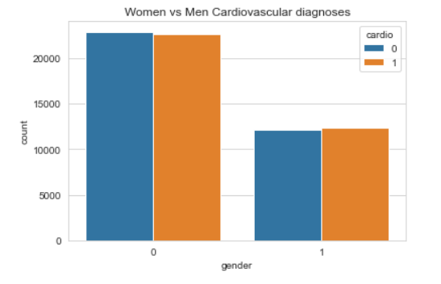
Findings From Report

Slide 7
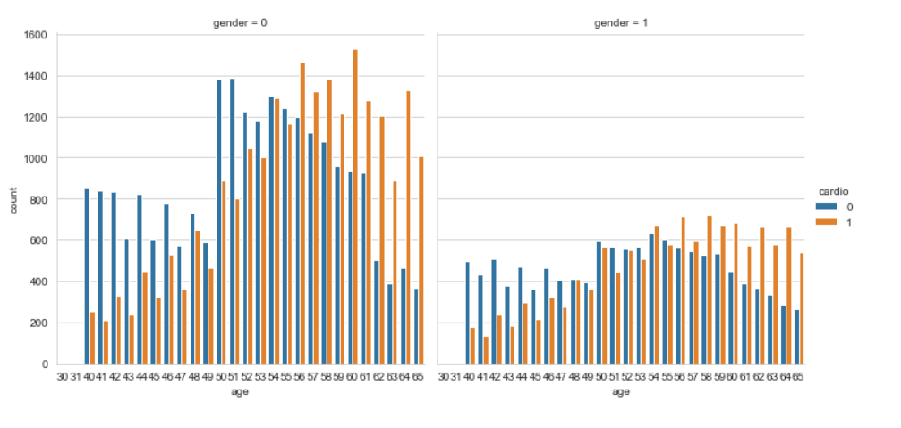
Findings From Report continued

Slide 8
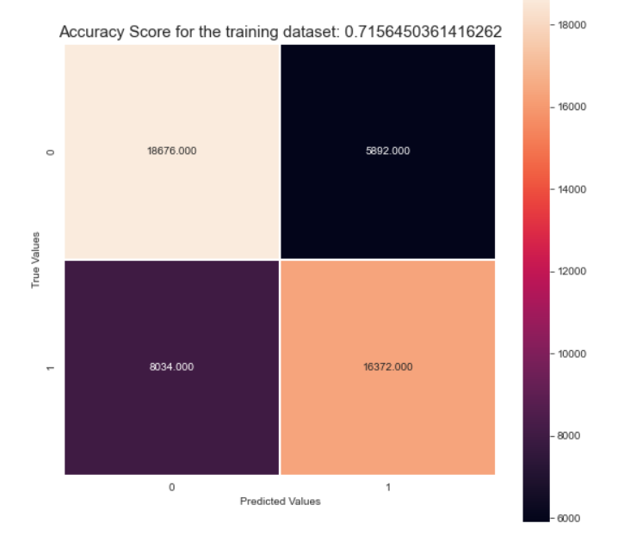
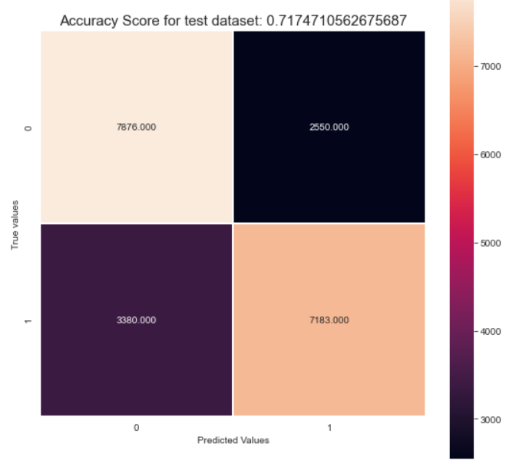
Model Findings Logistic Regression

Slide 9
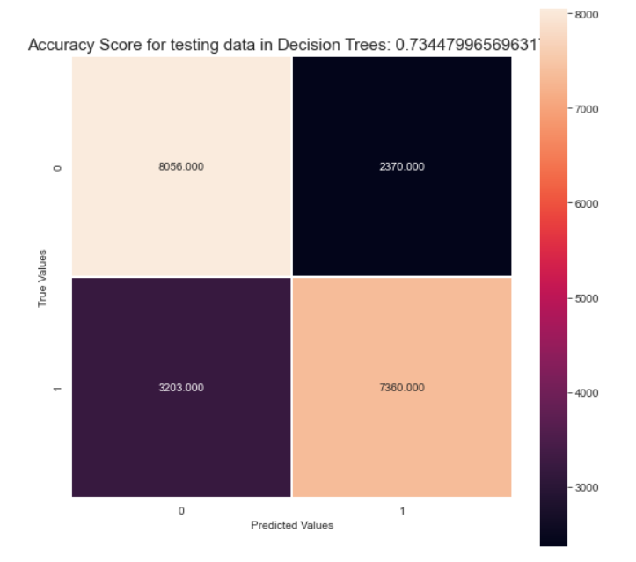
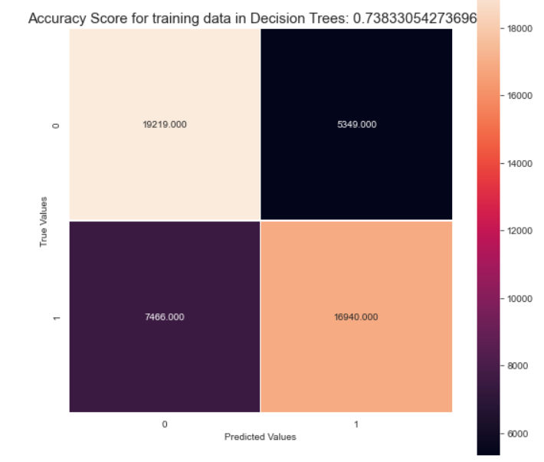
Model Findings Decision Trees Classification

Slide 10
Conclusion
When creating the two models I am seeing better performance in identifying positive and negative case of CVD in the Decision Tree classifier than that of the logistic regression.
For the Decision tree model all three precision, recall, and f1-score percentages are better than that of the logistic model. However with this this being a disease and a leader in American deaths we would want the accuracy for predicting positive and negative case to be significantly higher. We would want the accuracy in the threshold of 95-97% then that of 73-74% with about a +20% giving the wrong predictions.
I do believe that we can certainly improve this model and dataset to include certain food groupings and other health factors that are contributors to this disease that strengthen our predictions.

